Slide 1
Expert Systems Lesson 1

Slide 2
What is an expert system?
Expert systems use a knowledge base and a set of rules to provide a diagnosis or a recommended course of action. They can be used to solve complex problems by reasoning, using the knowledge base they are given.
An example is a medical expert system – a system that can help diagnose illnesses and then suggest treatment/solutions.

Slide 3
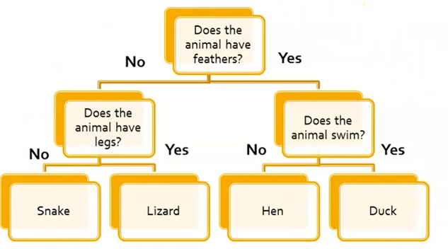
Very basic example of an expert system
Let's assume we want to identify an animal either as a duck, snake, lizard or Hen.

Slide 4
How does an expert system gather data from the user?
Expert systems are able to get the data necessary by asking the user of the expert system questions about the problem.
Depending on how the user responds to these questions, the expert system may continue to ask questions or may stop (if a conclusion has been achieved).

Slide 5
How does an expert system gather data from the user?
Based on what knowledge the expert system is given, it then determines what questions it needs to ask the user. The expert system then rules out possibilities depending on the answer from the user (to the questions).
This will help the expert system, while asking questions, to rule out possibilities until it reaches a diagnosis or decision.

Slide 6
What do we try and rely on expert systems for?
We rely on expert systems to help us with knowledge and understanding in a particular field.
A common example is finding the problem with our health or the problem with a car. We may use an expert system to help us diagnosis an illness we may have by responding to questions it asks US.
For example, "Do we have a fever?" - depending on our response it will then continue with a following question. Until it reaches a diagnosis (E.g. Sinus infection, cold, etc.).

Slide 7
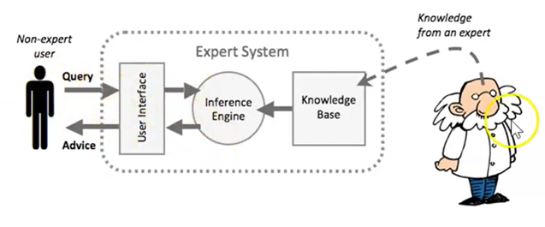
What are the three main components of an expert system?
The knowledge base
The inference engine
The user interface

Slide 8
What is the knowledge base?
A database of knowledge which has been provided by experts in a field

Slide 9

Who do the developers of the expert system interview to build the knowledge base of an expert system?
They interview a collection of experts (e.g. doctors if building an expert system for medical use) to collect the information needed to build the knowledge base.

Slide 10
What are the two types of knowledge that the developers will try to gain from experts for the knowledge base?
Factual knowledge: This is knowledge which is widely shared.
- Examples: Information found in textbooks, journals - generally information agreed upon (by experts in specific fields relating to that information).
Heuristic knowledge: This is knowledge that is more personal and is acquired through experiences and reasoning.
- Example: If a loudspeaker of the stereo system does not work and the settings of the amplifier have been checked, then the connections between the devices are faulty.

Slide 11
Part of the knowledge base is the Rules Base.
What is this?
The rules base is a set of rules (used by the inference engine) to obtain a solution decision to a problem

Slide 12
What are the two parts for the Rules Base?
Each rule will contain two parts, the IF and the THEN.
A rule can also have multiple IF parts that will be joined together by Boolean operators including AND and OR.
For example, IF an animal has feathers THEN it is a bird.

Slide 13

Thank You!

